Slide 1
Package Creation Overview

Slide 2
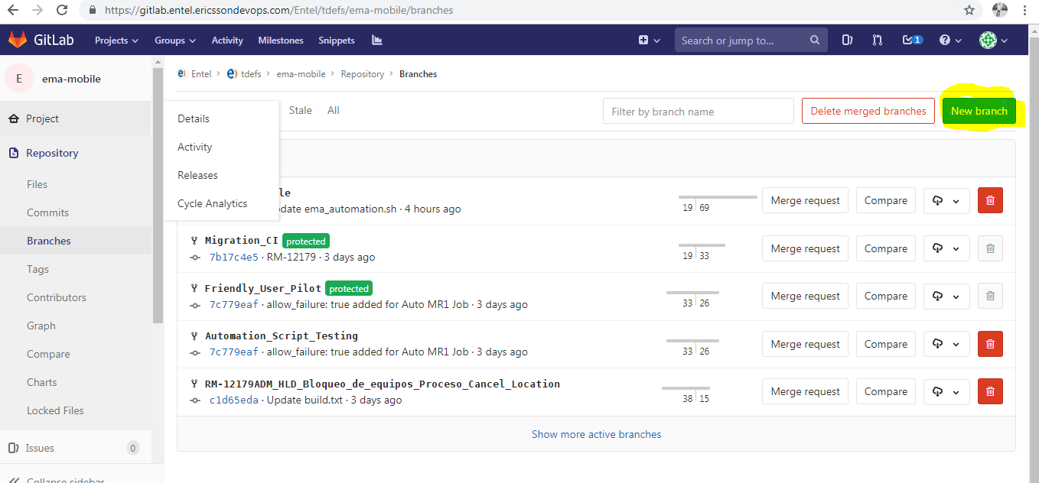
Temporary Branch Creation In GIT
First in GIT we create a temporary branch. For this open GIT GUI and click on New branch.

Slide 3
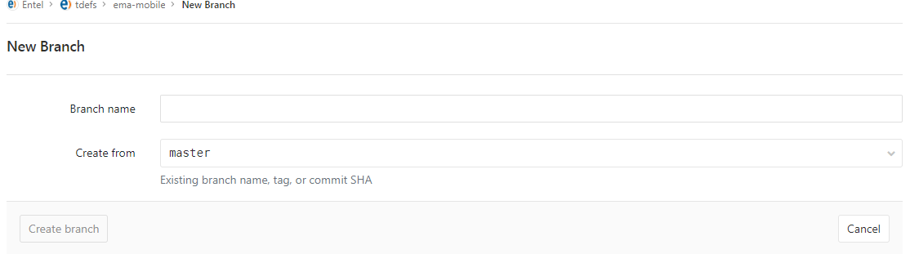
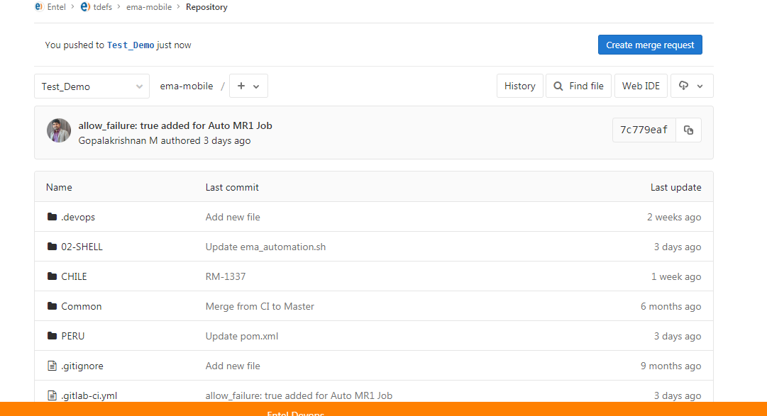
Temporary Branch Creation In GIT
Then we give the branch name and the branch name from which I am creating my temporary branch. Click on create branch. Now new branch is created.

Slide 4
GIT Branch Creation Nomenclature
Nomenclature for branches:
Nomenclature: Product_R**_Country_Stage_Name_JIRAID
R1A - Prepaid
R2A - CBIO Upgrade
R3A - Postpaid
Country - CL or PE or CO
Stage: DEV or IST or UAT or PROD
Sample: EOC_R3A_CL_DEV_Gopal_ENTELFT-01

Slide 5
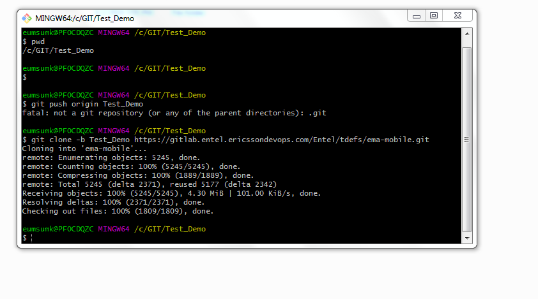
Local System
Now in local we create one folder and clone the code from that newly created branch in GIT.
Created one folder name Test_Demo and under that open git bash and run following command.
git clone -b Test_Demo https://gitlab.entel.ericssondevops.com/Entel/tdefs/ema-mobile.git

Slide 6
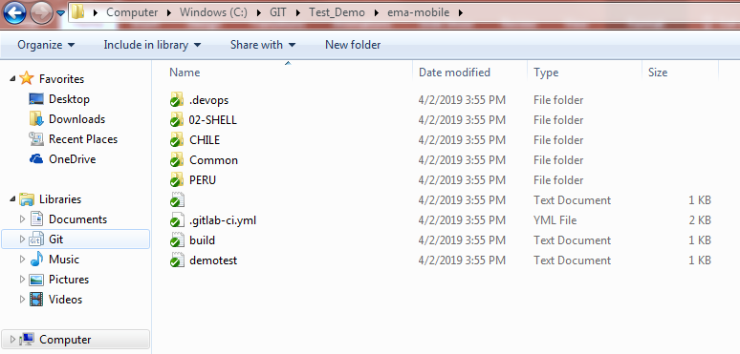
Local System
After clone all packages comes in local system.

Slide 7
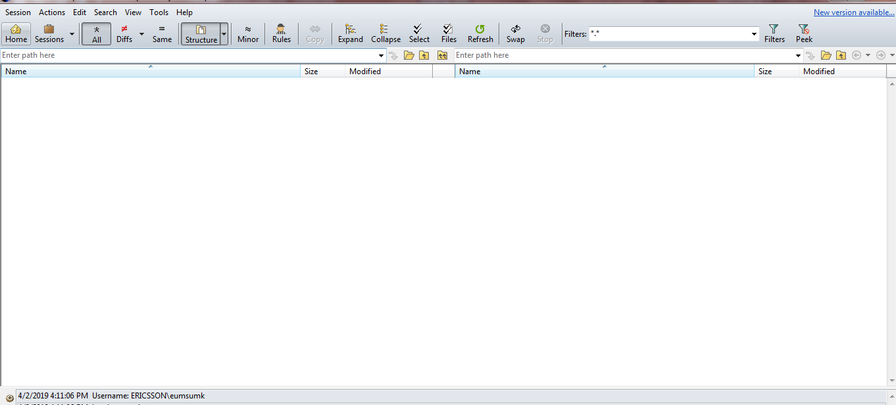
Merge
When code changes has been done then we merge our changes to the code in local. For merging we use Beyond compare software. In Beyond compare we compare the branch code to our changes and we merge our changes here in that branch.

Slide 8
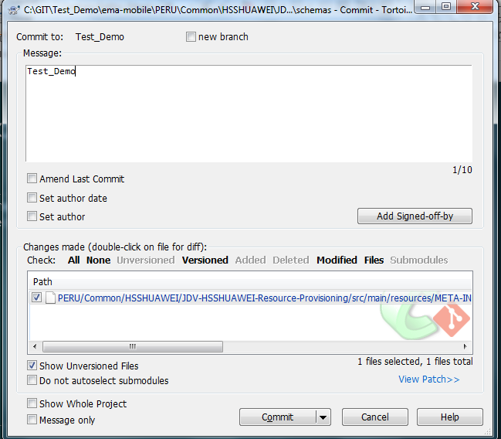
Commit
When merging is done then we do commit through git bash and give the message. Click on commit.

Slide 9
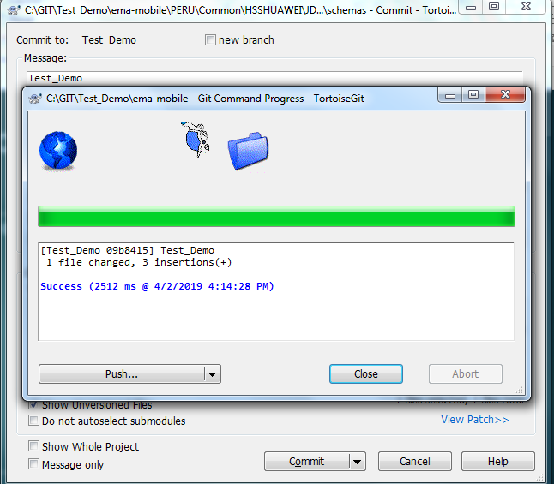
Push
When commit is successful then we got following messages. Click on push.

Slide 10
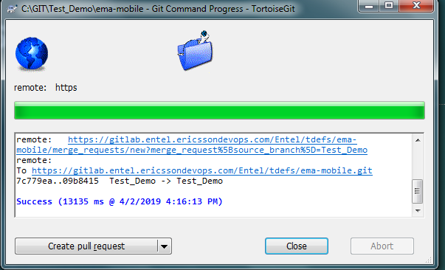
Push
After push we got below message and now our changes in pushed to the newly created branch in GIT.

Slide 11
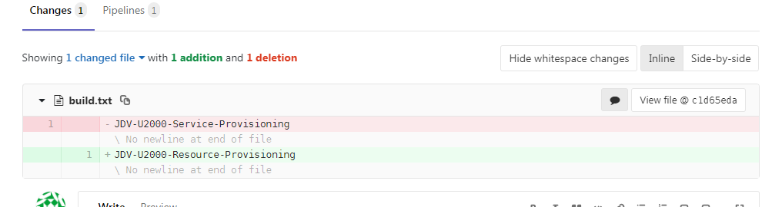
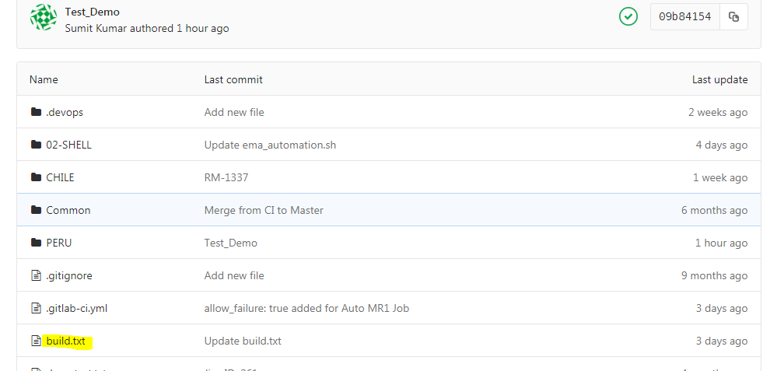
Create Merge Request
To create Merge Request the first step is to update build.txt files in GIT. Give the name of your build package. This package is the package name of component of application.

Slide 12
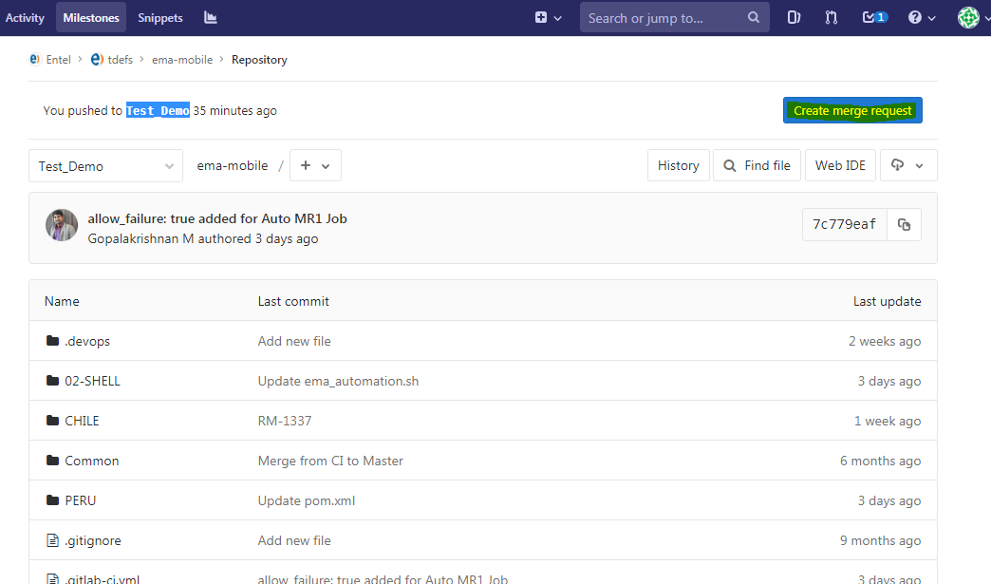
Create Merge Request
Now when all the changes pushed in GIT then we create merge request to build team to merge this changes to friendly_user_pilot branch.
To create merge request we go to GIT GUI.

Slide 13
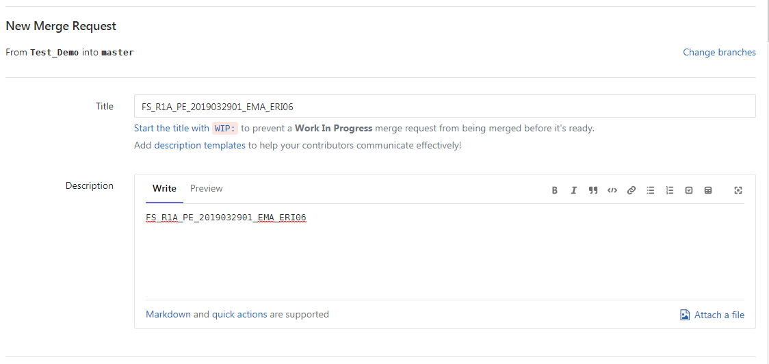
Create Merge Request
In merge request we need to provide input like below:
In title we have to provide the unique package name format defined by intel and the same build will be generated in Jfrog artifactory.
e.g- FS_R1A_PE_2019032901_EMA_ERI06

Slide 14
Create Merge Request
Nomenclature: Product_R**_Country_Stage_Name_JIRAID
R1A - Prepaid
R2A - CBIO Upgrade
R3A - Postpaid
Country - CL or PE or CO
Stage: DEV or IST or UAT or PROD
Sample: EOC_R3A_CL_DEV_Gopal_ENTELFT-01

Slide 15
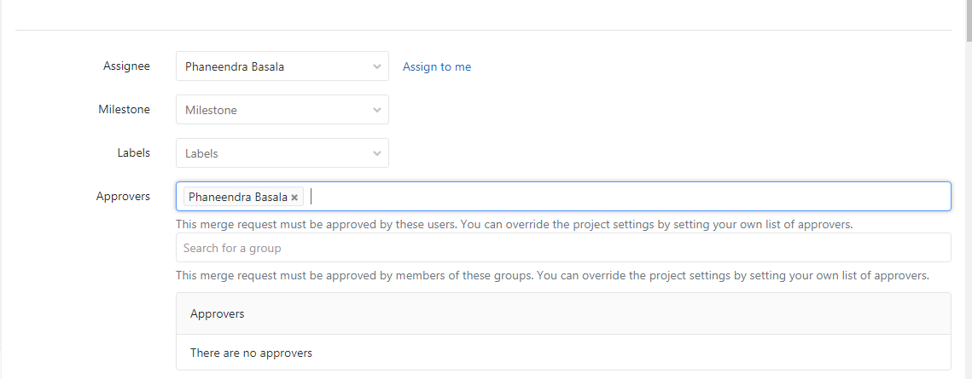
Create Merge Request

Slide 16
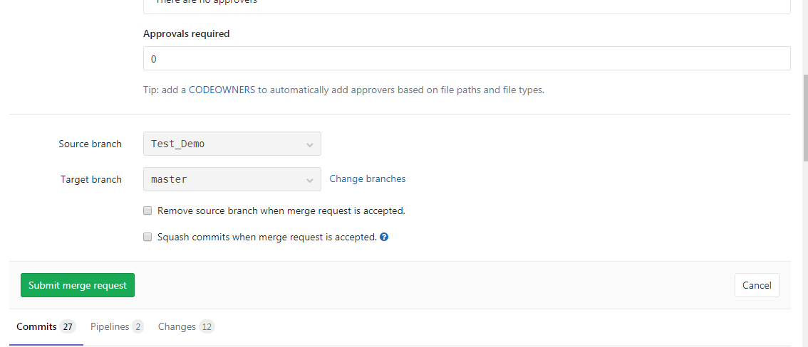
Create Merge Request
After providing each input click on submit merge request.

Slide 17
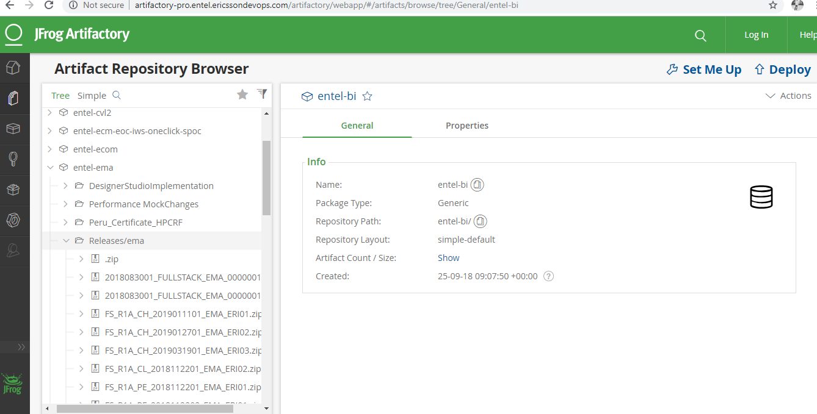
Jfrog Artifactory
We create merge request to merge our changes to all other branches in GIT and when build team approves then we get the corresponding build in Jfrog.

Slide 18
Jira Ticket
We need to login to JIRA using below URL:
https://tdentel.atlassian.net/secure/WelcomeToJIRA.jspa
In next slide will tell you the mandatory input needed to fill while creating JIRA. The remaining input you can ignore and fill these mandatory input carefully.

Slide 19
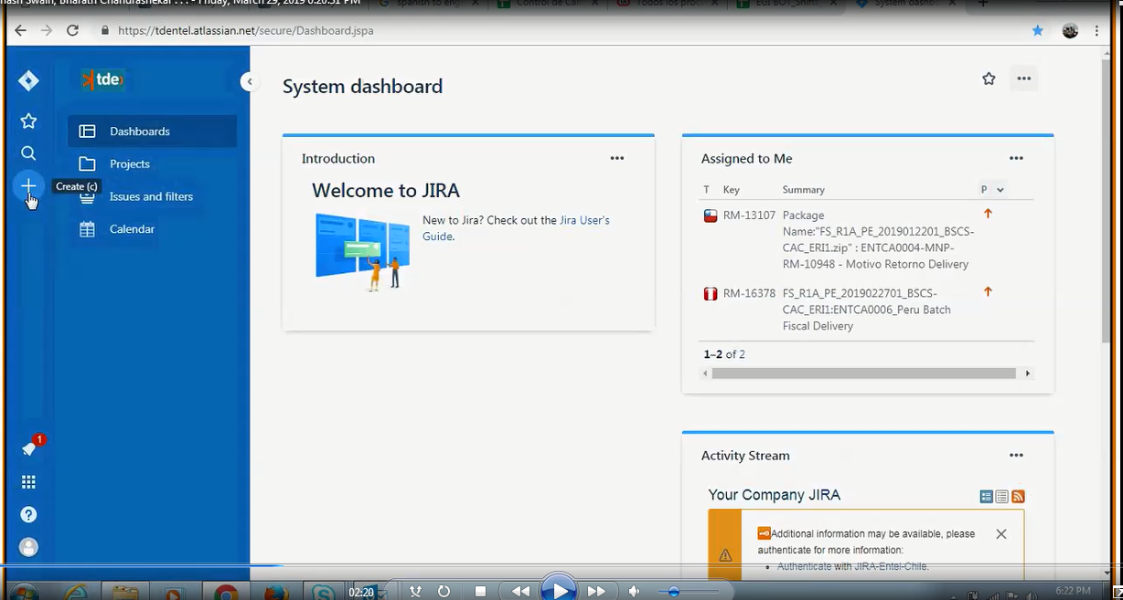
Jira Ticket
Click on new button.

Slide 20
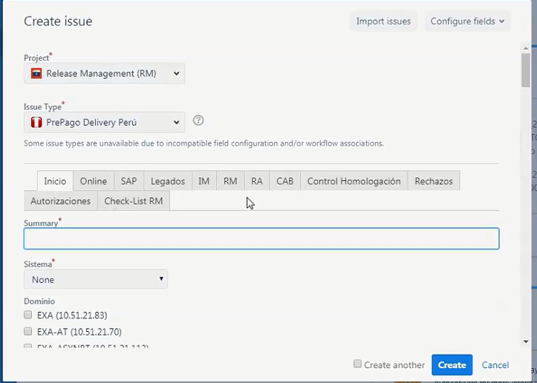
Jira Ticket
After clicking new button you will get following:

Slide 21
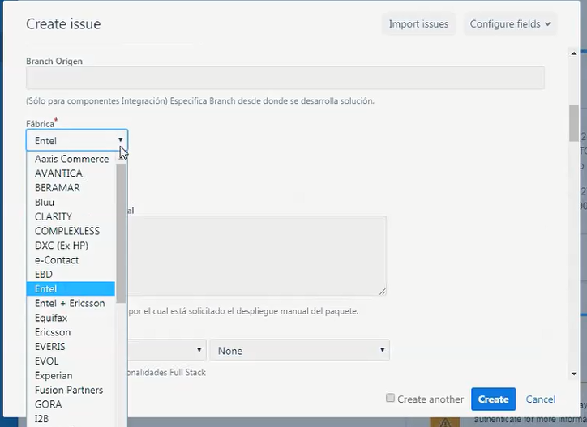
Jira Ticket
1. In issue type we need to select this JIRA ticket is for Chile or Peru and is it Prepaid or Postpaid selecting the options given.
2. In summary we have to provide package name.
e.g- FS_R1A_PE_2019032901_EMA_ERI06
3. In system we need to select the system which is responsible for the package.
e.g- EMA
4. The fabrica will be Ericsson if it is from ADM prespective.

Slide 22
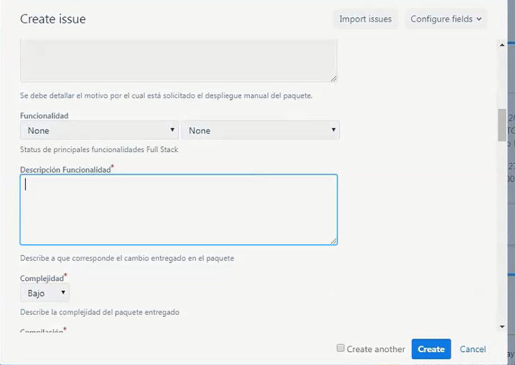
Jira Ticket
5. type of deployment will be manual.
6. description functionality will be the country code concatenated with package name.
e.g- Peru FS_R1A_PE_2019032901_EMA_ERI06

Slide 23
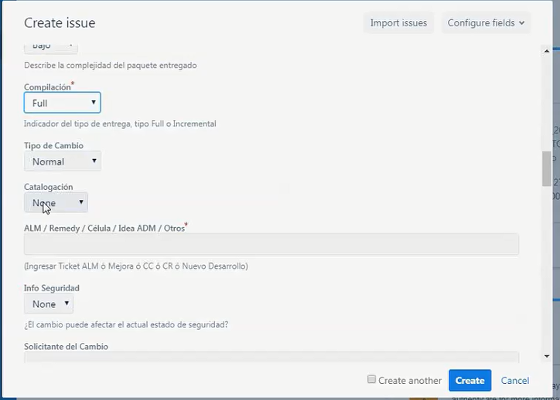
Jira Ticket
7. compilation will be full.
8.ALM/Remedy this filed will be the JIRA or CR no.

Slide 24
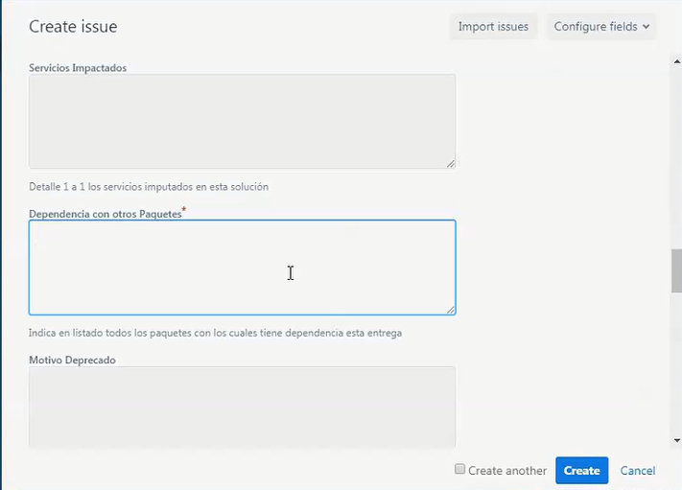
Jira Ticket
9. In below the input will be the dependency of this package with last deployed package.

Slide 25
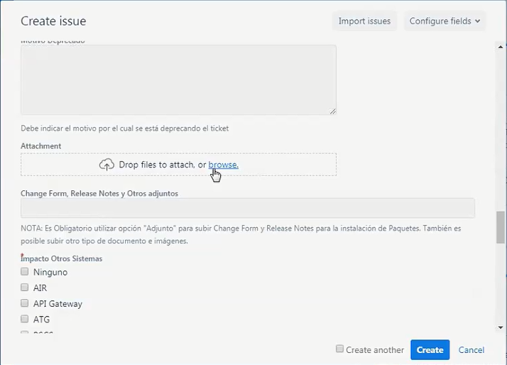
Jira Ticket
10. In below tab we attach change form and release form.

Slide 26
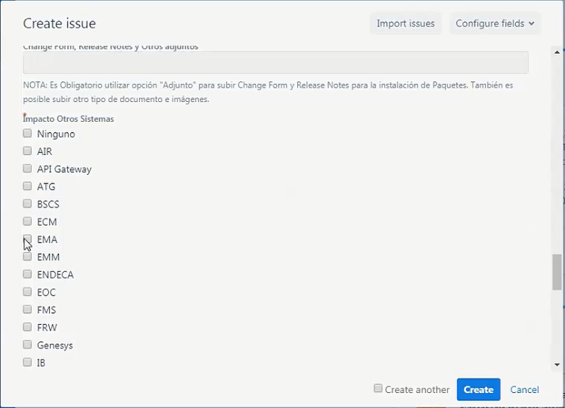
Jira Ticket
11. In below tab the input will be the impact on another system.

Slide 27
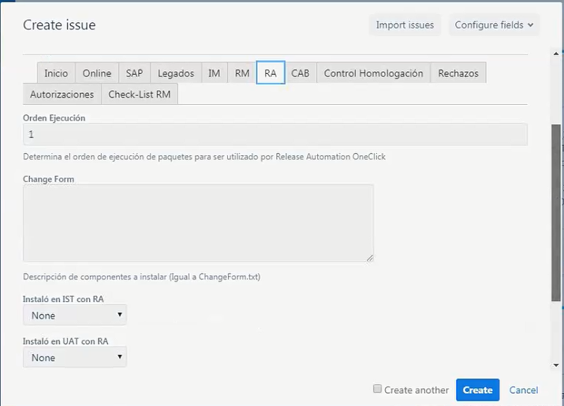
Jira Ticket
RA Section:

Slide 28
Jira Ticket
In RA section in change form section need to mention the object list.
That’s all in RA Section.

Slide 29
Jira Ticket
Now click on create and it will create JIRA ticket.

Slide 30
Change Form
Change Form is needed for JIRA creation and it includes the details of all deployable component and the command and step of deployment, creation and configure network element in EMA, configuring parameters of JDV and SV.

Slide 31
Thank you

